Slide 1
An application of network meta-analysis Is electronic cigarette effective for smoking cessation?
Dr. Gary Chan
NHMRC Emerging Leadership Fellow
National Centre for Youth Substance Use Research, UQ

Slide 2

Network meta-analysis
Non-technical overview
Rücker, G. (2012). "Network meta‐analysis, electrical networks and graph theory." Research synthesis methods 3(4): 312-324.
Mills, E. J., et al. (2013). "Demystifying trial networks and network meta-analysis." BMJ 346: f2914.
Chaimani, A., et al. (2019). "Undertaking network meta‐analyses." Cochrane Handbook for Systematic Reviews of Interventions: 285-320.
Borenstein, M., et al. (2010). "A basic introduction to fixed‐effect and random‐effects models for meta‐analysis." Research synthesis methods 1(2): 97-111.
An application of network meta-analysis to evaluate the effectiveness of e-cigarette for smoking cessation
GitHub:
https://github.com/gckc123/ecig_quitting_review
Twitter:
@ncysur_epi
@GaryCkChan
@GaryCKChan
Notes:
An overview of NMA
Non-technical, Touch on the key idea conceptually

Slide 3
Network meta-analysis
An application of network meta-analysis to evaluate the effectiveness of e-cigarette for smoking cessation
Can e-cigarette help smokers quit?
Is e-cigarette more effective than traditional nicotine replacement therapy such as nicotine patches?
GitHub:
https://github.com/gckc123/ecig_quitting_review
Twitter:
@ncysur_epi
@GaryCkChan
@GaryCKChan

Slide 4
Meta-analysis
Evidence synthesis
Follow a systematic search of existing literature on a research question
Is cognitive behavioural therapy effective for alcohol use disorder?
Can E-cigarette help smokers quit cigarette smoking?
Create a pooled estimates based on all existing literature
@GaryCKChan

Slide 5
Meta-analysis
Fixed-effect model
One effect size that underlies all the studies in the analysis
Differences between studies are due to sampling error only
Common-effect model
Random-effects model
Studies may share a common effect size
Also possible that the effect size varies from study to study
There is a distribution of effect size
If there is substantial variation (i.e. heterogeneity) in the study sample/ design, a random effect is usually more appropriate.
Borenstein, M., et al. (2010). "A basic introduction to fixed‐effect and random‐effects models for meta‐analysis." Research synthesis methods 1(2): 97-111.
@GaryCKChan

Slide 6
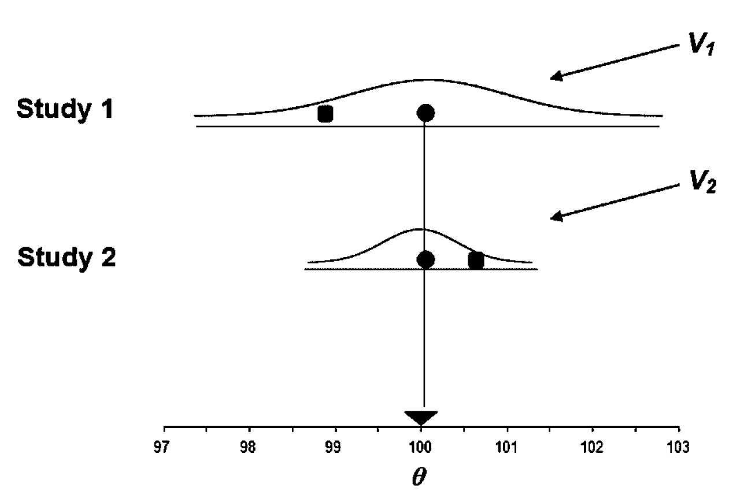
Meta-analysis
Fixed-effect model
One effect size that underlies all the studies in the analysis
Differences between studies are due to sampling error only
Common-effect model
Random-effects model
Studies may share a common effect size
Also possible that the effect size varies from study to study
There is a distribution of effect size
If there is substantial variation (i.e. heterogeneity) in the study sample/ design, a random effect is usually more appropriate.
Figure taken from Borenstein, M., et al. (2010). "A basic introduction to fixed‐effect and random‐effects models for meta‐analysis." Research synthesis methods 1(2): 97-111.
@GaryCKChan

Slide 7
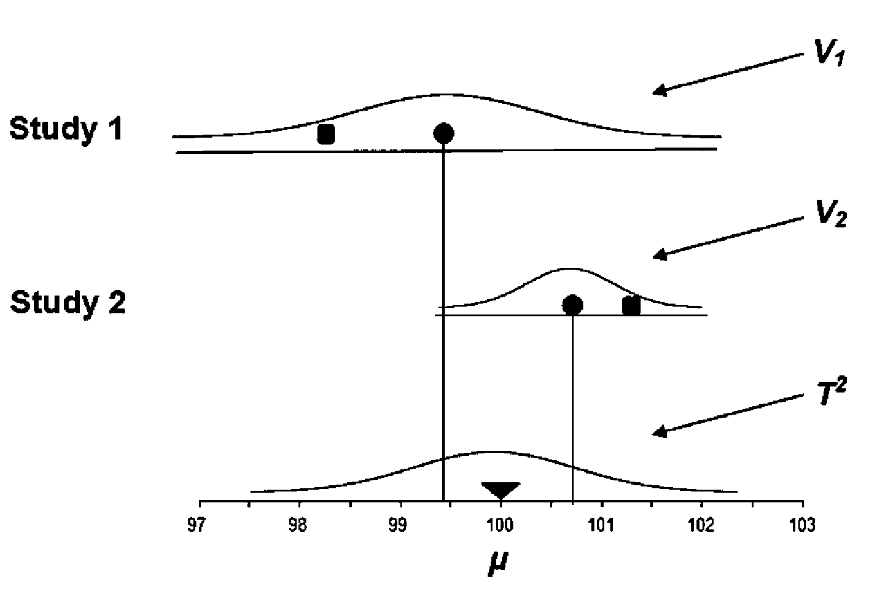
Meta-analysis
Fixed-effect model
One effect size that underlies all the studies in the analysis
Differences between studies are due to sampling error only
Common-effect model
Random-effects model
Studies may share a common effect size
Also possible that the effect size varies from study to study
There is a distribution of effect size
If there is substantial variation (i.e. heterogeneity) in the study sample/ design, a random-effects model is usually more appropriate.
Figure taken from Borenstein, M., et al. (2010). "A basic introduction to fixed‐effect and random‐effects models for meta‐analysis." Research synthesis methods 1(2): 97-111.
@GaryCKChan

Slide 8
Network meta-analysis
Traditional meta-analysis useful for comparing two treatments
Nicotine replacement therapy vs control condition in smoking cessation
For most medical conditions, there are often more than one treatment
Smoking cessation
Nicotine replacement therapy
E-cigarette
Alcohol use disorder
Pharmacological treatment
Cognitive Behavioral Therapy
Alcoholic Anonymous
Network meta-analysis is an extension of traditional meta-analysis
Network of interventions
Multiple ways to make indirect comparison
Combined direct and indirect comparison for inference
@GaryCKChan

Slide 9
E-cigarette and smoking cessation
Policies for e-cigarette have been under heated debate
Australia is the only western democracy that bans sales of nicotine solution for e-cigarette use
Advocates of e-cigarette
It could help millions of Australian smokers quit cigarette smoking, leading to tremendous gain in public health and cost saving from smoking related diseases.
Opponents of e-cigarette
There is no solid evidence that e-cigarette help quit smoking, and it might act as a gateway for young people to start cigarette smoking.
Even e-cigarette can help smokers to quit, there are other equally effective products such as nicotine replacement therapy (NRT).
@GaryCKChan

Slide 10
E-cigarette and smoking cessation
Policies for e-cigarette have been under heated debate
Australia is the only western democracy that bans sales of e-cigarette
Advocates of e-cigarette
It could help millions of Australian smokers quit cigarette smoking, resulted in tremendous gain in public health and cost saving from smoking related diseases.
Opponents of e-cigarette
There is no solid evidence that e-cigarette help quit smoking, and it might act as a gateway for young people to start cigarette smoking.
Even e-cigarette can help smokers to quit, there are other equally effective products such as nicotine replacement therapy (NRT).
@GaryCKChan

Slide 11
E-cigarette and smoking cessation
Is e-cigarette effective for smoking cessation compared to control condition?
Is e-cigarette more effective than nicotine replacement therapy?
NRTs
E-cigarette
Control
@GaryCKChan

Slide 12
E-cigarette and smoking cessation
Is e-cigarette effective for smoking cessation compared to control condition?
Is e-cigarette more effective than nicotine replacement therapy?
Direct comparison
E-cigarette vs control
NRTs
E-cigarette
Control
@GaryCKChan

Slide 13
E-cigarette and smoking cessation
Is e-cigarette effective for smoking cessation compared to control condition?
Is e-cigarette more effective than nicotine replacement therapy?
Indirect comparison
E-cigarette vs NRTs
NRTs vs Control
NRTs
E-cigarette
Control
@GaryCKChan

Slide 14
E-cigarette and smoking cessation
Is e-cigarette effective for smoking cessation compared to control condition?
Is e-cigarette more effective than nicotine replacement therapy?
Indirect comparison
E-cigarette vs NRTs
NRTs vs Control
NRTs
E-cigarette
Effect(E-cig vs control) through indirect comparison
= Effect(E-cig vs NRTs) + Effect(NRTs vs control)
Control
@GaryCKChan

Slide 15
E-cigarette and smoking cessation
Is e-cigarette effective for smoking cessation compared to control condition?
Is e-cigarette more effective than nicotine replacement therapy?
Direct comparison
E-cigarette vs NRTs
NRTs
E-cigarette
Control
@GaryCKChan

Slide 16
E-cigarette and smoking cessation
Is e-cigarette effective for smoking cessation compared to control condition?
Is e-cigarette more effective than nicotine replacement therapy?
Indirect comparison
E-cigarette vs Control
NRTs vs Control
NRTs
E-cigarette
Control
@GaryCKChan

Slide 17
E-cigarette and smoking cessation
Is e-cigarette effective for smoking cessation compared to control condition?
Is e-cigarette more effective than nicotine replacement therapy?
Indirect comparison
E-cigarette vs Control
NRTs vs Control
NRTs
Effect(E-cig vs NRTs) through indirect comparison
= Effect(E-cig vs Control) – Effect(NRTs vs Control)
Control
E-cigarette
@GaryCKChan

Slide 18
E-cigarette and smoking cessation
Network meta-analysis exploits all available direct and indirect evidence.
More powerful, better estimates (if the assumption is satisfied)
Key assumption:
The studies in the meta-analysis are independent.
The underlying effects are consistent (known as the transitivity assumption).
Direct effect is “consistent” with indirect effect
E.g. Effect(e-cig vs control) through direct comparison = Effect(e-cig vs control) through indirect comparison
NRTs
E-cig
Control
@GaryCKChan

Slide 19
Transitivity – E-cigarette vs control
Indirect comparison
E-cigarette vs NRTs
NRTs vs control
The NRTs studies in E-cigarette vs NRTs comparison similar to the NRTs studies in NRTs vs control comparison
If NRTs studies in the first comparison (E-cigarette vs NRTs) were mostly based on participants with mental health problems, and the NRTs studies in the second comparison (NRTs vs control) comparison were mostly based on general population, the transitivity assumption is unlikely to hold.
NRTs
E-cig
Control
@GaryCKChan

Slide 20
Transitivity – E-cigarette vs control
Inevitable difference between studies in systematic review
Are these differences large enough to induce “intransitivity”?
If NRTs studies in the first comparison (E-cigarette vs NRTs) were mostly based on participants with mental health problems, and the NRTs studies in the second comparison (NRTs vs control) were mostly based on general population, the transitivity assumption is unlikely to hold.
If NRTs studies in the first comparison were mostly based on female, and the NRTs studies in the second comparison were mostly based on male, the transitivity assumption may still NOT be violated if the effect of NRTs on smoking cessation is similar for males and female (i.e. Gender does not modify the effect of NRTs on smoking cessation).
NRTs
E-cig
Control
@GaryCKChan

Slide 21


Accessing transitivity
Are the distribution of effect modifiers across different comparisons similar?
The gender composition of the NRT studies in the E-cigarette vs NRTs comparison and in the NRTs vs control comparison are the similar
The gender composition of the NRT studies in the E-cigarette vs NRTs comparison and in the NRTs vs control comparison are different, but gender is not an effect modifier (No gender differences in the effect of NRTs on smoking cessation)
The mental health profile of participants of the NRT studies in the E-cigarette vs NRTs comparison and in the NRTs comparison are different, and mental health is a known effect modifier (NRTs might only be effective among participants with no mental health problem)
NRTs
E-cig
Control
@GaryCKChan

Slide 22
Performing Network Meta-analysis in R
The Netmeta package (Rucker et al, 2014)
Other packages available (e.g. the “gemtc” package)
NRTs
E-cig
Control
@GaryCKChan

Slide 23
Data preparation
Five key columns
Study label
Multi-arm study
Two columns specifying the comparisons
Effect size
Odds ratio, risk ratio (relative risk) and hazard ratio needs to be converted into log-OR, log-RR and log-HR respectively
Standard error of the effect size
@GaryCKChan

Slide 24
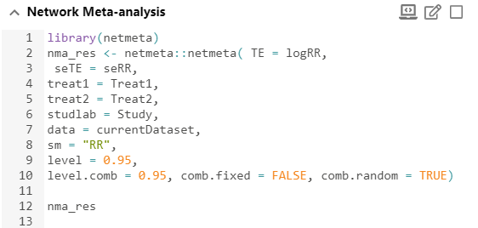
Network meta-analysis in R
@GaryCKChan

Slide 25
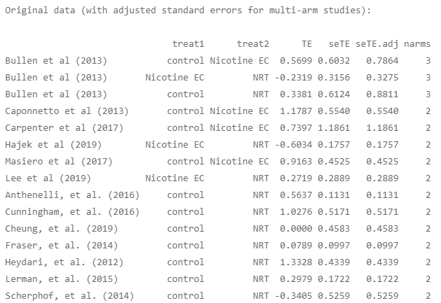
Network meta-analysis in R
@GaryCKChan

Slide 26
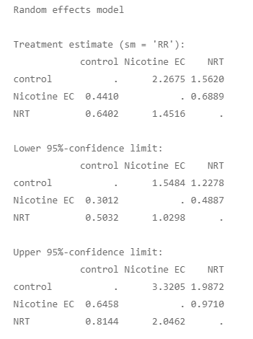
Network meta-analysis in R
Based on both direct and indirect evidence, smokers who used E-cig were more likely to stop smoking than smokers in the control condition, RR = 2.27, 95% CI = (1.55, 3.32)
@GaryCKChan

Slide 27
Network meta-analysis in R
Based on both direct and indirect evidence, smokers who used E-cig were more likely to stop smoking than smokers in the control condition, RR = 2.27, 95% CI = (1.55, 3.32)
Smokers who used NRTs were more likely to stop smoking than smokers in the control condition, RR = 1.56, 95% CI = (1.23, 1.99)
@GaryCKChan

Slide 28
Network meta-analysis in R
Based on both direct and indirect evidence, smokers who used E-cig were more likely to stop smoking than smokers in the control condition, RR = 2.27, 95% CI (1.55, 3.32)
Smokers who used NRTs were more likely to stop smoking than smokers in the control condition, RR = 1.56, 95% CI (1.23, 1.99)
Smokers who used E-cig were more likely to stop smoking than smokers who used NRTs, RR = 1.45, 95% CI (1.03, 2.05).
@GaryCKChan

Slide 29
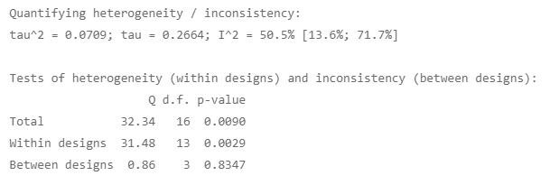
Network meta-analysis in R
Five key studies designs
Control vs NRT
E-cig vs NRT
Control vs E-cig
Control vs NRT in 3-arm studies
Control vs E-cig in 3-arm studies
@GaryCKChan

Slide 30

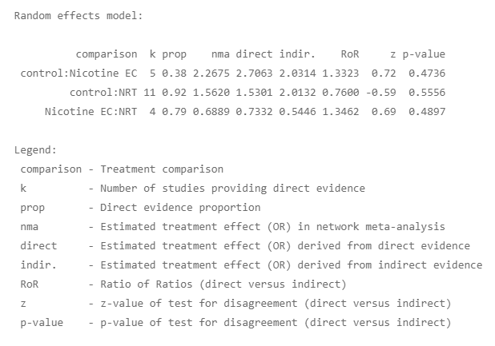
Network meta-analysis in R
@GaryCKChan

Slide 31

Network meta-analysis in R
@GaryCKChan

Slide 32
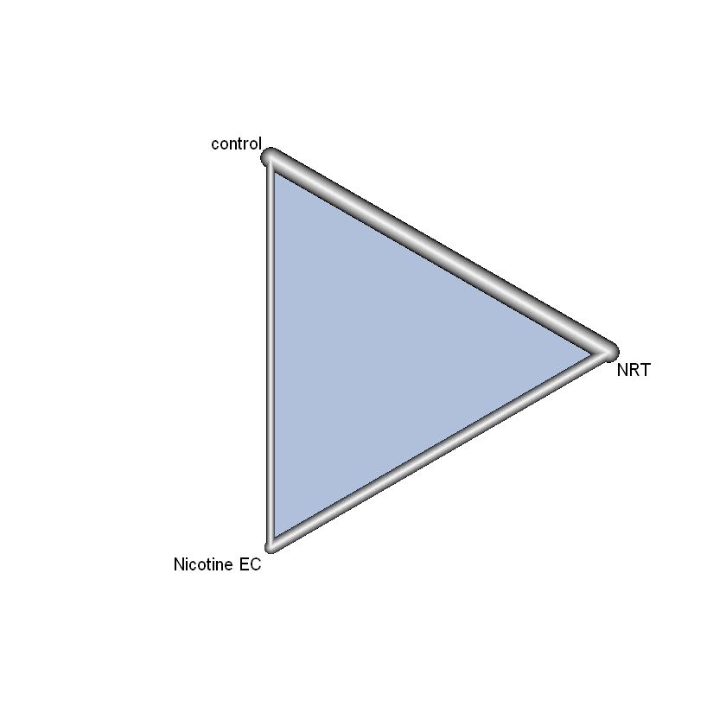

Network meta-analysis in R
@GaryCKChan

Slide 33
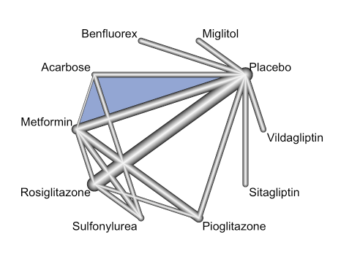
Network meta-analysis in R
More informative for more interventions
@GaryCKChan

Slide 34
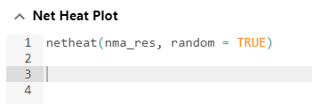
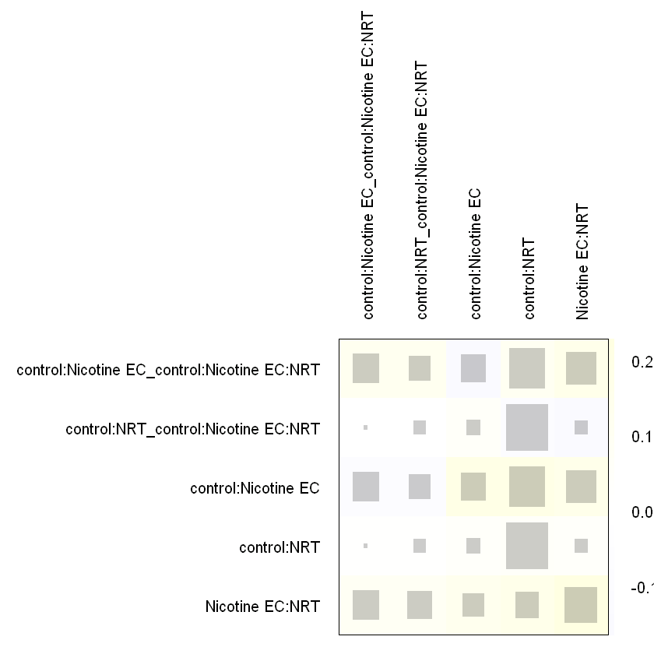
Network meta-analysis in R
Net heat plot
Grey square
Pairwise comparisons from three-arm design designated by “_” (Column 1 and 2; Row 1 and 2)
Area proportional to the contribution from the treatment comparison in the column to the treatment comparison in the row.
Square on the diagonal thus represents contribution from direct comparison for a particular design.
@GaryCKChan

Slide 35

Network meta-analysis in R
Net heat plot
Grey square
Pairwise comparisons from three-arm design designated by “_” (Column 1 and 2)
Area proportional to the contribution from the treatment comparison in the column to the treatment comparison in the row.
E.g. in the control vs E-cig comparison (third row), the largest contribution was from the design “control vs NRT” (fourth column), followed by the design “E-cig vs NRT” (fifth column).
The contribution from direct comparison from two-arm design (third column) and from three-arm design was relatively smaller (first column).
@GaryCKChan

Slide 36
Network meta-analysis in R
Net heat plot
Color on the diagonal
Decompose the inconsistency (between-design component) to each design
Design contributing to high inconsistency were shown in red.
@GaryCKChan

Slide 37
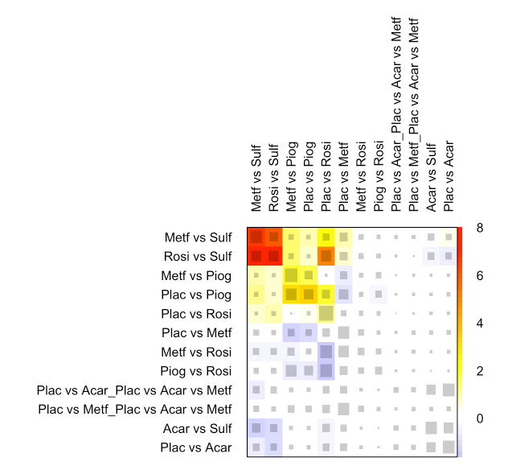
Network meta-analysis in R
@GaryCKChan

Slide 38
Network meta-analysis in R
Net heat plot
Color on the off diagonal
Further break down the inconsistency from a particular design into its contributing components
What contributes to the inconsistency from a particular design?
@GaryCKChan

Slide 39

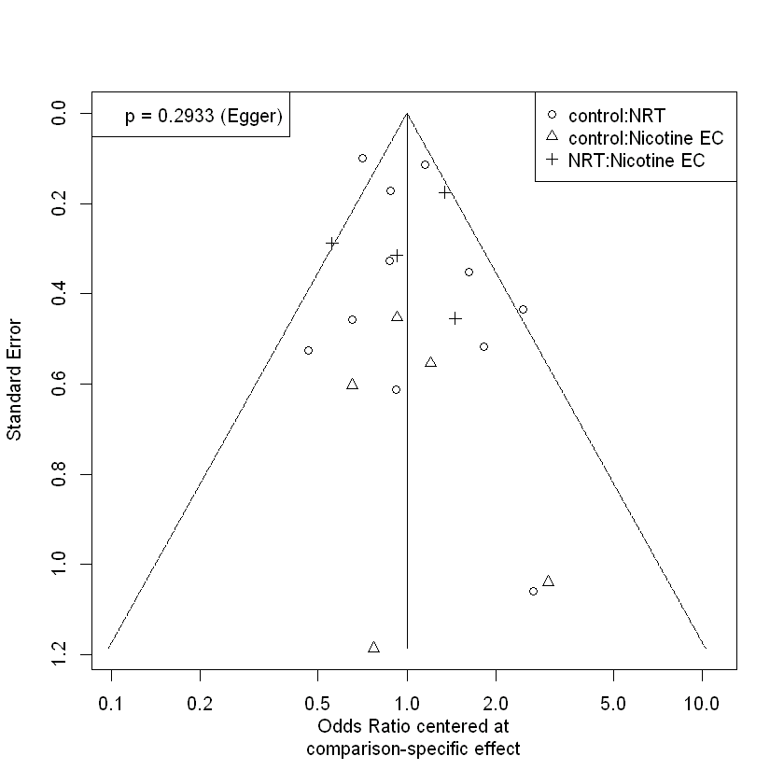
Network meta-analysis in R
@GaryCKChan

Slide 40
Lastly…
@GaryCKChan

Slide 41

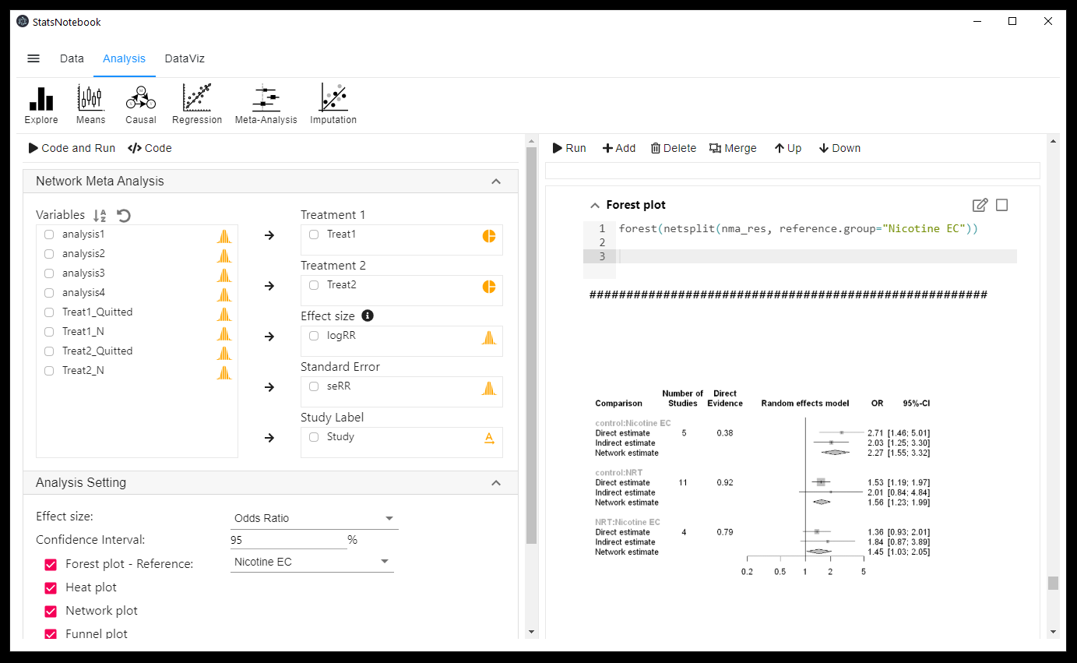
StatsNotebook
@GaryCKChan

Slide 42
StatsNotebook
Free Open source statistical software
Simplicity
Functionality
Reproducibility
Mission
Provide a viable open-source alternative to commercial software (e.g. SPSS, STATA, etc)
@GaryCKChan

Slide 43
StatsNotebook
Demo
Conduct network meta-analysis in 2mins
Data file https://github.com/gckc123/ecig_quitting_review
@GaryCKChan

Slide 44

StatsNotebook
Will be officially released in October/November
Testing version available on request
Free workshops on conducting various analyses using R and StatsNotebook
Longitudinal data analysis
Causal mediation analysis
Moderation/interaction analysis
Missing data handling
Handling distributional assumption violation in general linear model
Data visualization
Volunteers will be needed to develop wiki pages/ tutorial pages
@GaryCKChan
Facebook.com/StatsNotebook
@GaryCKChan

Slide 45





Thank you
Dr Gary Chan | NHMRC Emerging Leadership Fellow
Chief software engineer - StatsNotebook
National Centre for Youth Substance Use Research
c.chan4@uq.edu.au
facebook.com/StatsNotebook
---------------------------------------
@GaryCKChan
---------------------------------------
---------------------------------------

